Slide 1
Microsoft Dynamics 365 Data entity
Áttekintés és gyakorlati tapasztalatok
Prokopecz Péter

Slide 2
Bemutatkozás
Prokopecz Péter
AX technical lead @ JJ Food Service Ltd. (Food wholesale)
Cégvezető @ DAXVision ERP Consulting Kft. (Your external AX tech. team)
http://www.daxvisionerp.com/
info@daxvisionerp.com
Tanulmányok: IT mérnök + MBA (angolul)
Tapasztalat: 2003 óta AX

Slide 3
Miről lesz szó
Data entity áttekintés
Data management – Vendor invoice automation
Entity demo
OData
Composite data entity
Tapasztalatok

Slide 4

Áttekintés/bevezetés

Slide 5
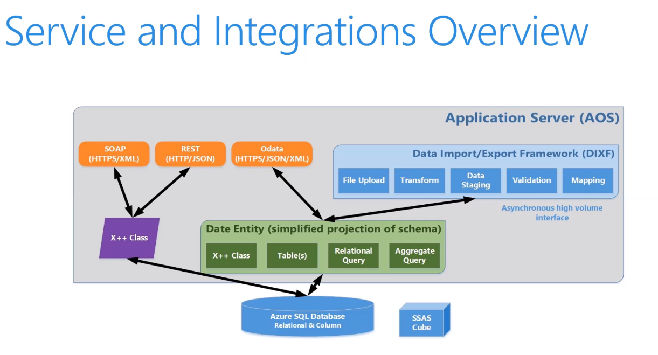
Services and integration
+ Azure Data Lake storage gen2!

Slide 6
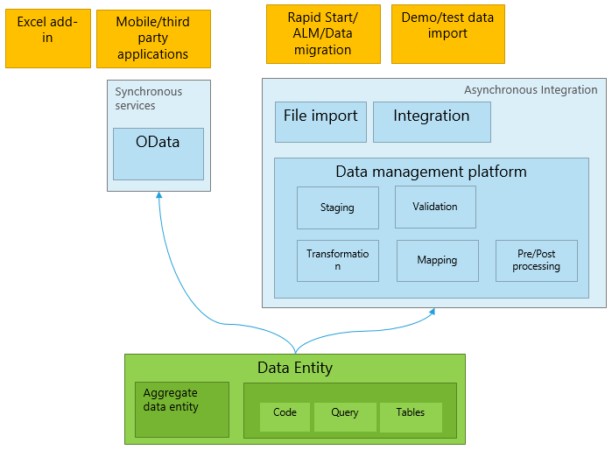
Data entity áttekintés
DMF->DIXF->D365 Data Entity
http://daxvisionerp.com/call-ax-data-entity-from-postman/
http://daxvisionerp.com/excels-query-from-odata-feed-to-access-your-data-entity/
Notes:
2 min

Slide 7
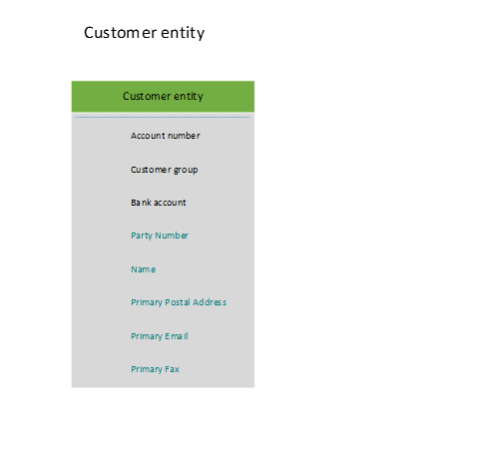
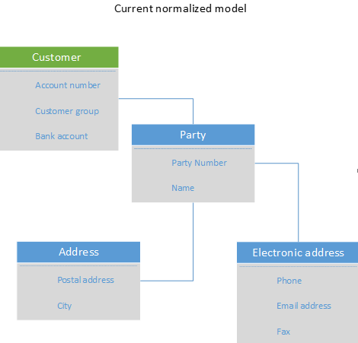
Data entity áttekintés
Normalizálás – Redundancia/függőségek
I. NF (elemi értékek és függnek a kulcstól)
II. NF (összetett kulcs részétől)
III. NF (tranzitív függőségek: függőség nem kulcs mezőktől)
Notes:
2 min

Slide 8
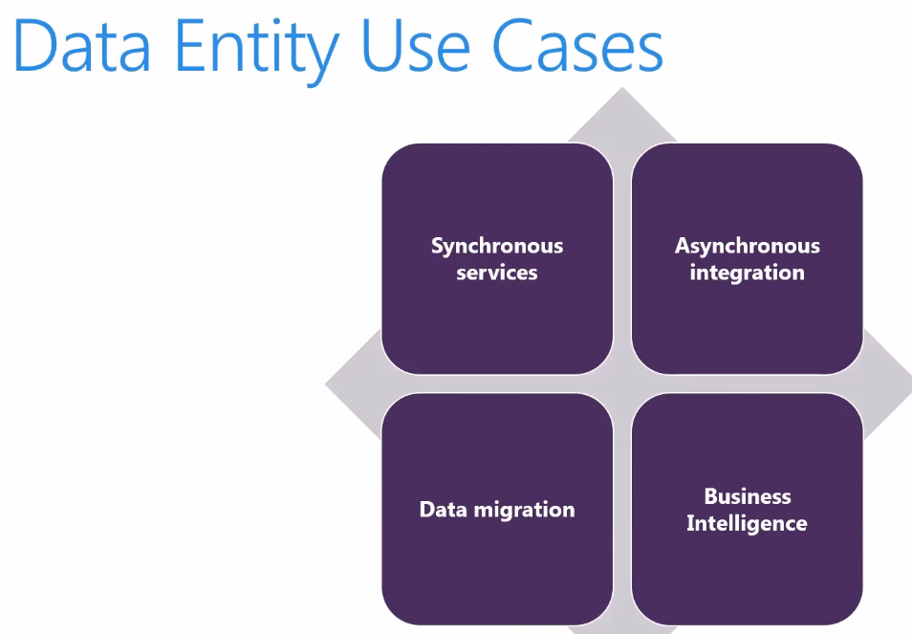
(Azure Data Lake!)

Slide 9
Data management

Slide 10
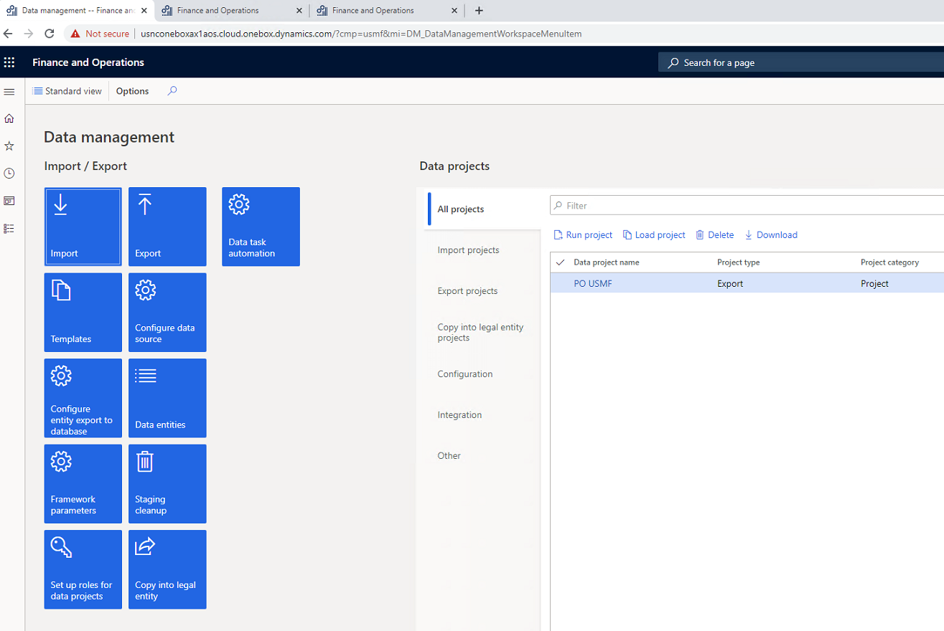
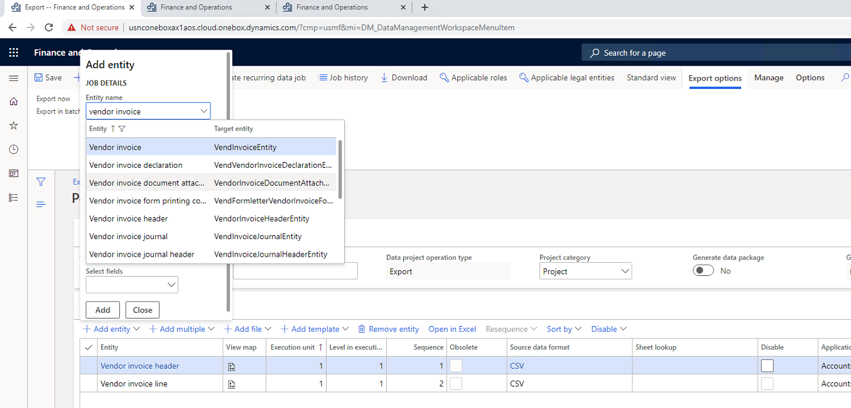
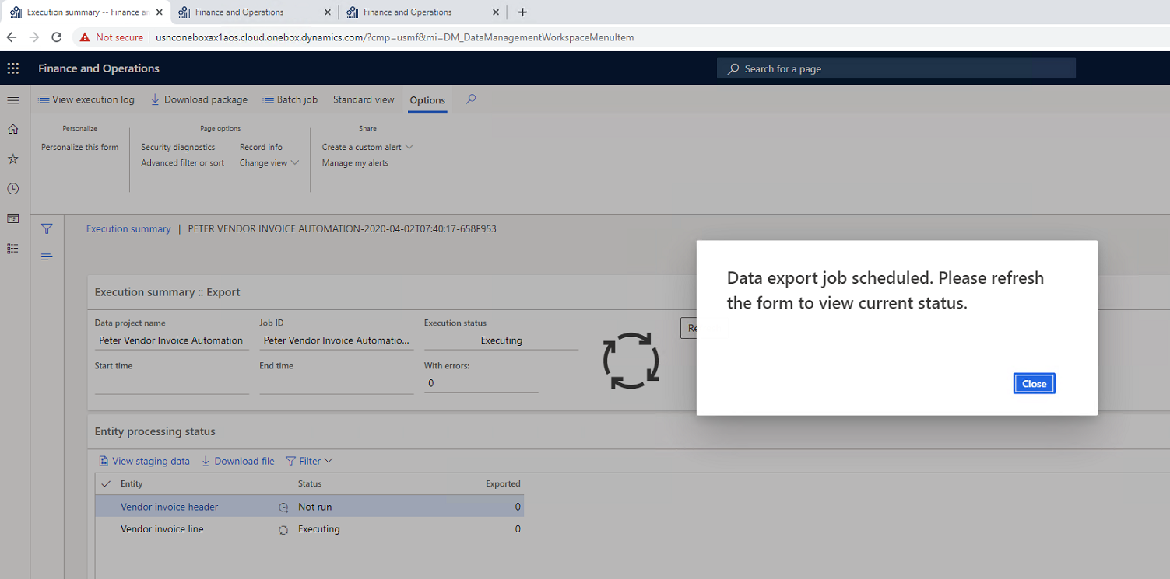
Data management UI

Slide 11
Vendor invoice automation
Accounts payables > Invoices > Pending vendor invoices
Vendor invoice header
Vendor invoice line
Vendor invoice document attachment
https://docs.microsoft.com/en-us/dynamics365/finance/accounts-payable/vendor-invoice-automation

Slide 12
Demo
Data management

Slide 13
Data entity fejlesztés

Slide 14
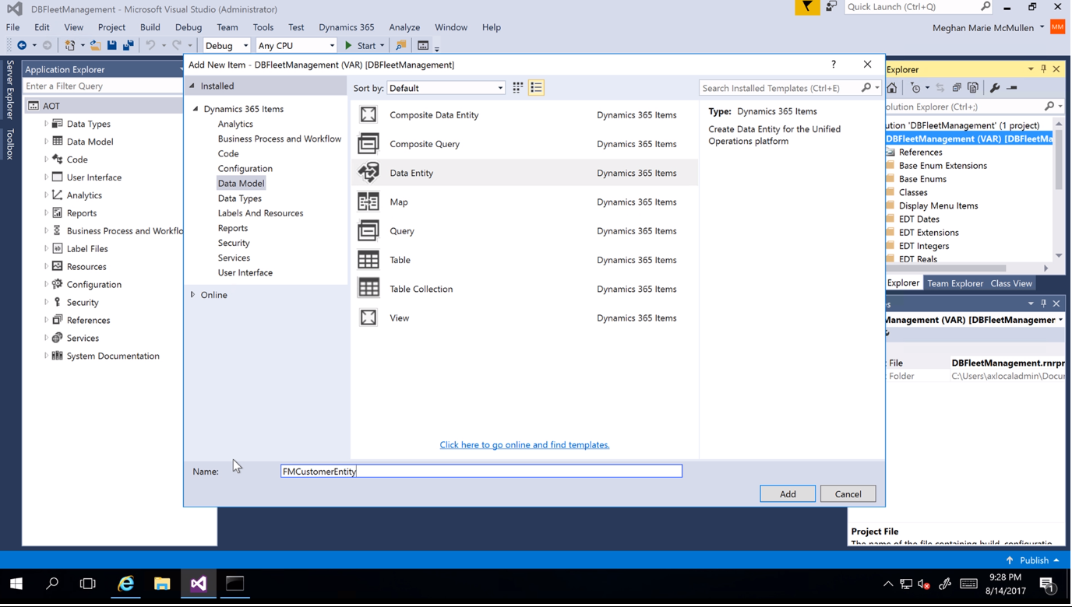
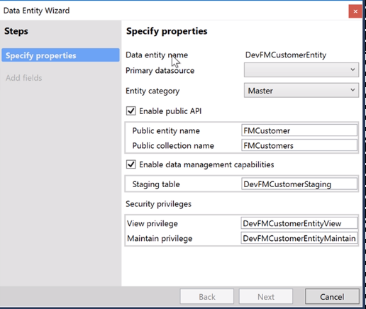
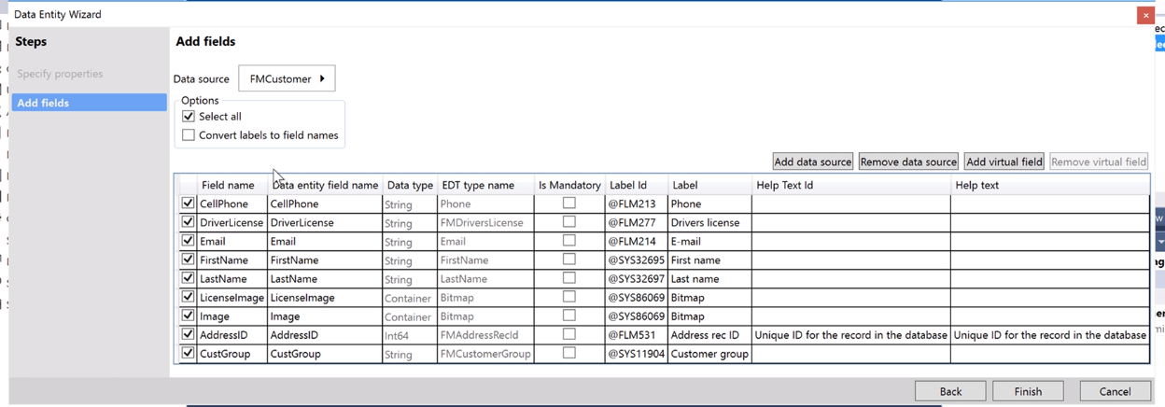
Creating Data entities

Slide 15
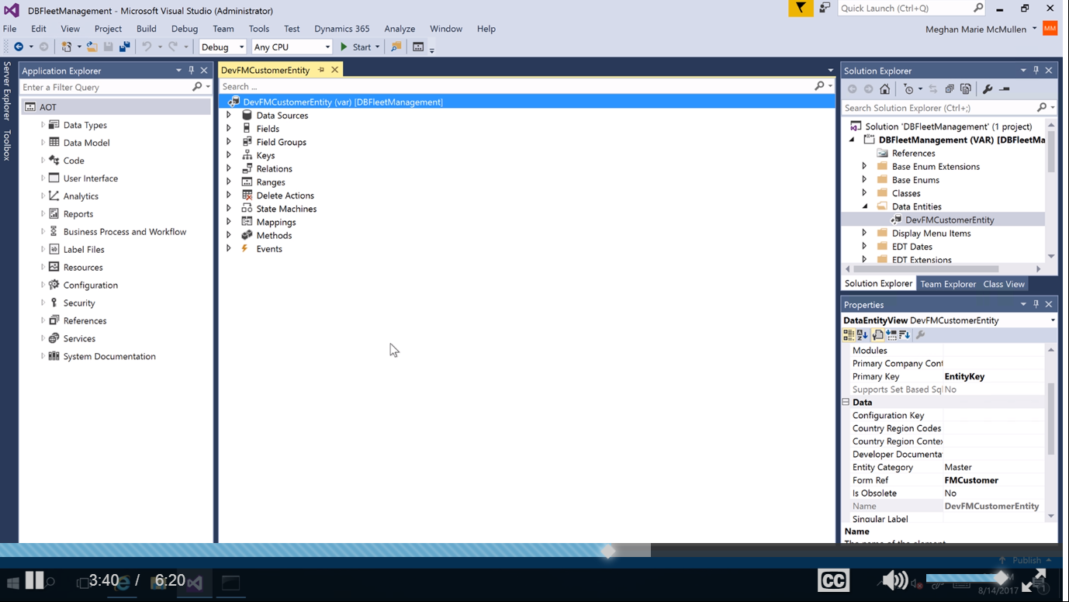
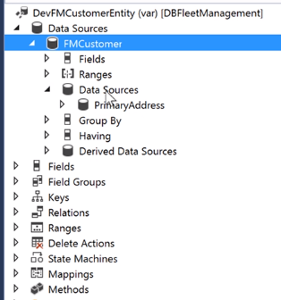
Data entity in AOT

Slide 16
DEV
Név: <prefix><ConceptualName>Entity
Entity&view
Legegyszerűbb teszt: runnable class, x++ select

Slide 17
Demo
Data entity készítés

Slide 18
Unmapped mező típusok
Computed
T-SQL – SQL View-ban Computed column
gyorsabb, bonyolultabb
http://daxvisionerp.com/view-computed-column-using-replace/
Virtual
X++ kód (postLoad metódus) - Olyan mint a táblákon a display metódusok
Soronként hajtódik végre
Perfomancia miatt a computed column előnyösebb!
https://docs.microsoft.com/en-us/dynamics365/fin-ops-core/dev-itpro/data-entities/data-entity-computed-columns-virtual-fields

Slide 19
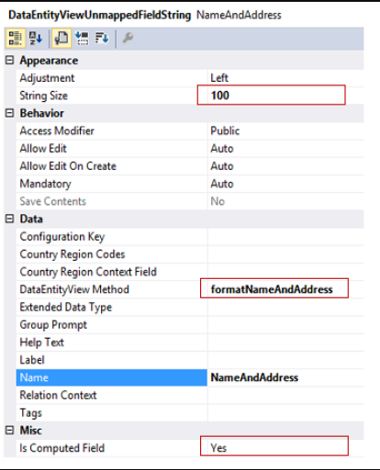
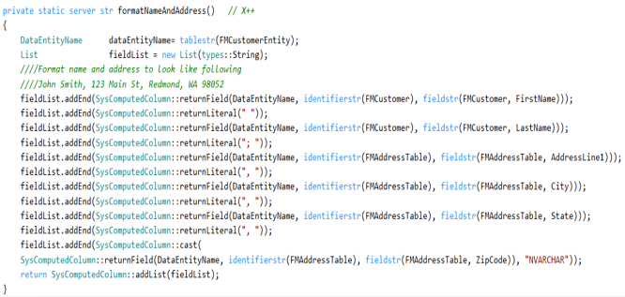
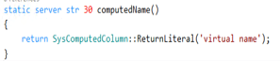
Computed

Slide 20
Demo
Computed column

Slide 21
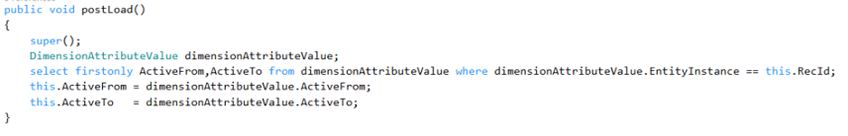
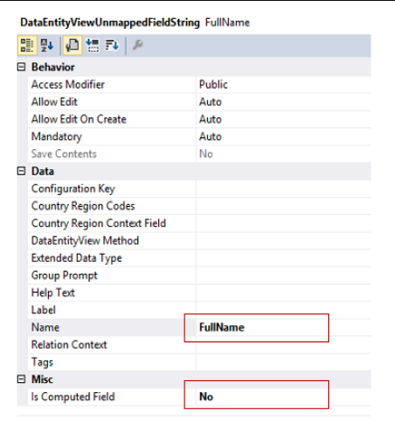
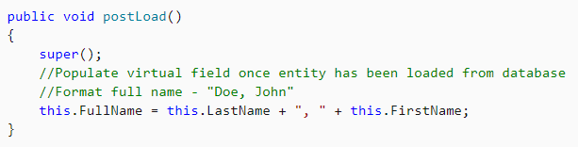
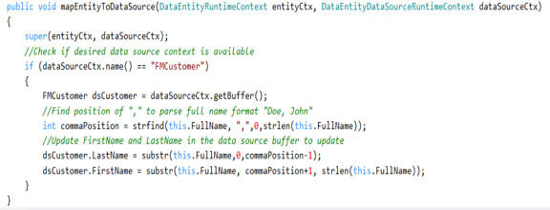
Virtual field

Slide 22
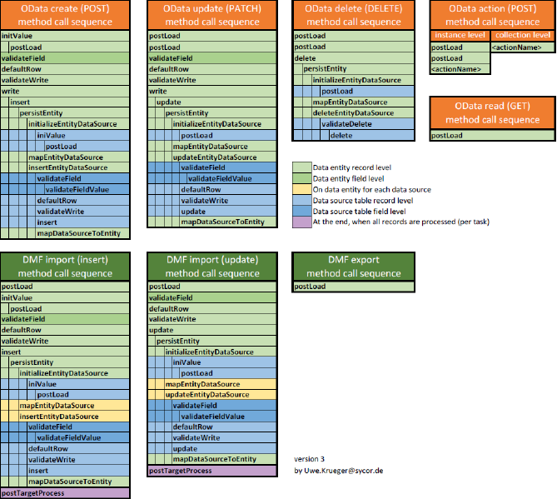
Method sequence

Slide 23
OData

Slide 24
Services and integration

Slide 25
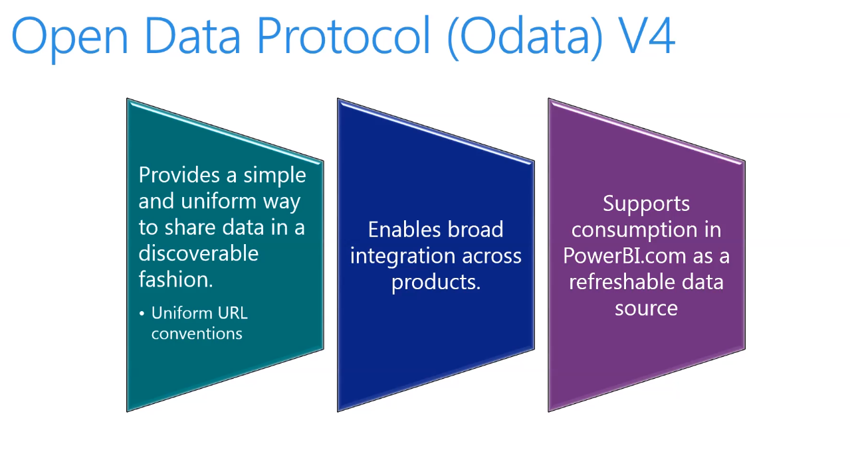
ODATA
Nem adatmigrációra való

Slide 26
- $filter - $count - $orderby - $skip - $top - $expand - $select
ODATA – v4.0 lekérdezési opciók

Slide 27
Odata query
URL | Description
[Your organization's root URL]/data/Customers | List all the customers.
[Your organization's root URL]/data/Customers?$top=3 | List the first three records.
[Your organization's root URL]/data/Customers?$select=FirstName,LastName | List all the customers, but show only the first name and last name properties.
[Your organization's root URL]/data/Customers?$format=json | List all the customers in a JSON format that can be used to interact with JavaScript clients.

Slide 28
Demo
OData böngésző és Excel

Slide 29
Test OData
http://daxvisionerp.com/call-ax-data-entity-from-postman/
http://daxvisionerp.com/excels-query-from-odata-feed-to-access-your-data-entity/
Notes:
2 min

Slide 30
Demo
OData Postman

Slide 31
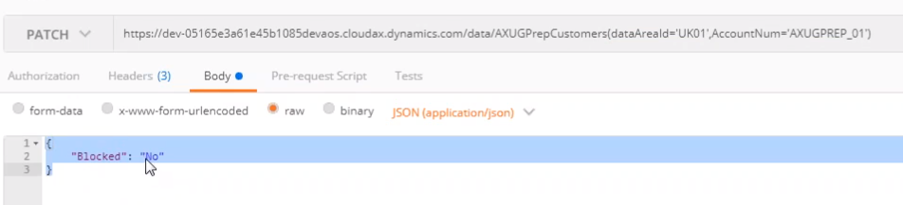
Update
Reference: AXUG Webinar, Cruz Margaix, How to develop your OData endpoints (Downloaded: 1.4.2020)

Slide 32
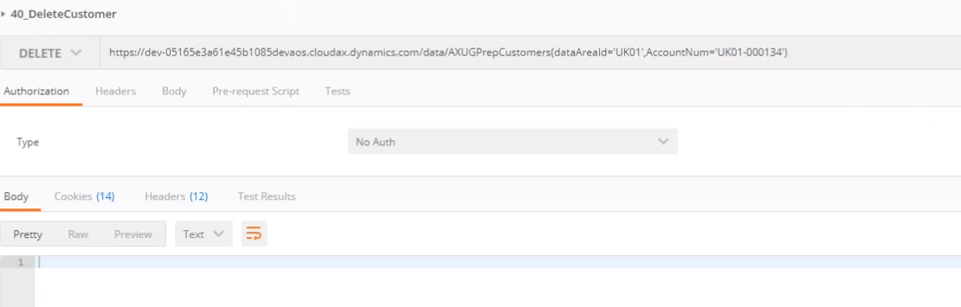
Delete
Reference: AXUG Webinar, Cruz Margaix, How to develop your OData endpoints (Downloaded: 1.4.2020)

Slide 33
Odata Enum
Enums namespace: Microsoft.Dynamics.DataEntities.
Enum syntax:
Microsoft.Dynamics.DataEntities.Gender'Unknown'
Microsoft.Dynamics.DataEntities.NoYes'Yes’
Példa enum használatra (eq és ne használható) :
https://environment.cloud.onebox.dynamics.com/data/CustomersV3?\$filter=PersonGender eq Microsoft.Dynamics.DataEntities.Gender'Unknown'
https://environment.cloud.onebox.dynamics.com/data/Currencies?\$filter=ReferenceCurrencyForTriangulation eq Microsoft.Dynamics.DataEntities.NoYes'No'

Slide 34
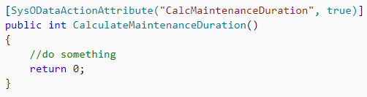
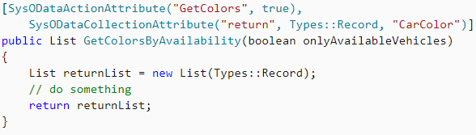
Odata Action
Üzleti logika hozzáadása Odata entitihez

Slide 35
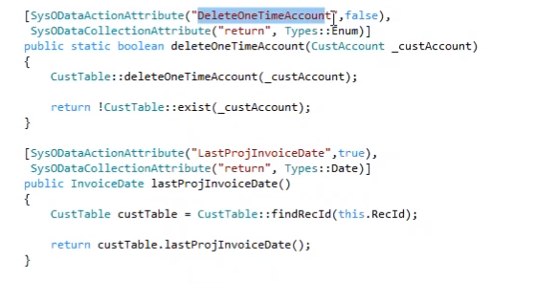
Odata action
Reference: AXUG felvétel

Slide 36
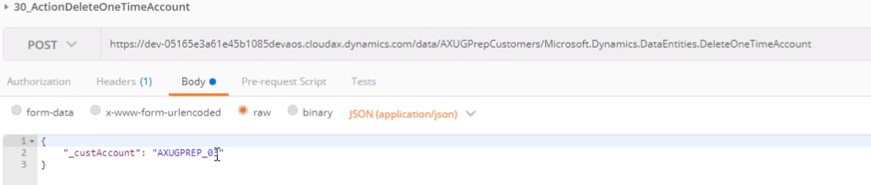
Odata action
Reference: AXUG Webinar, Cruz Margaix, How to develop your OData endpoints (Downloaded: 1.4.2020)

Slide 37
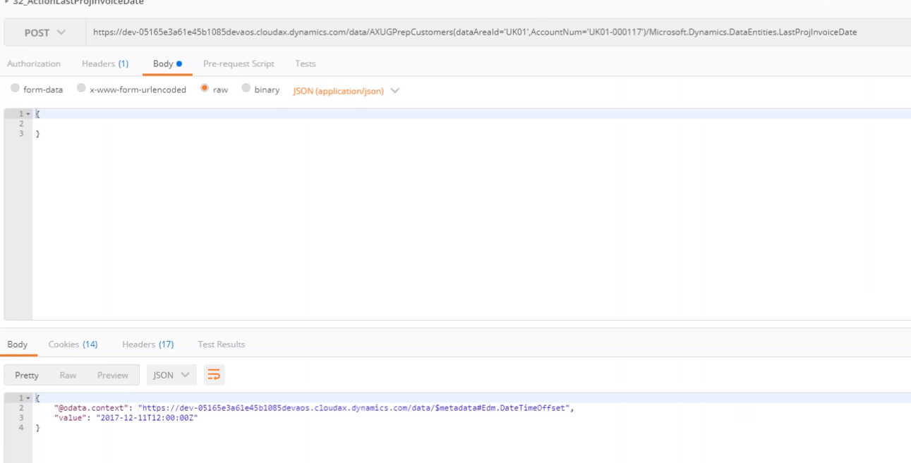
Odata action
Reference: AXUG Webinar, Cruz Margaix, How to develop your OData endpoints (Downloaded: 1.4.2020)

Slide 38
Composite data entity

Slide 39
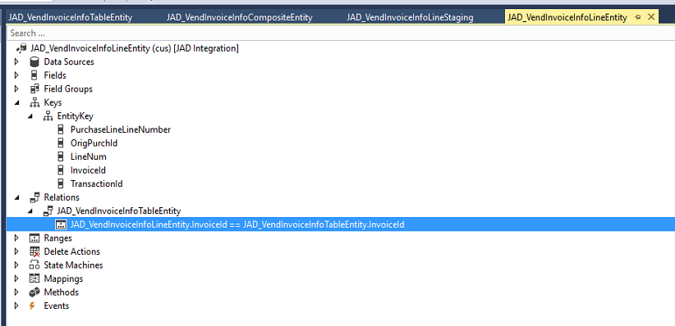
Line entity: add relation to header

Slide 40
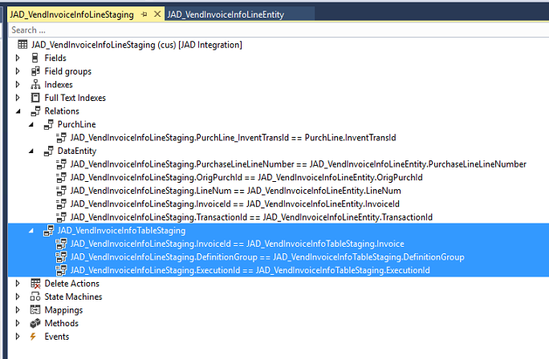
Line staging: add relation (include system added 2 fields)

Slide 41
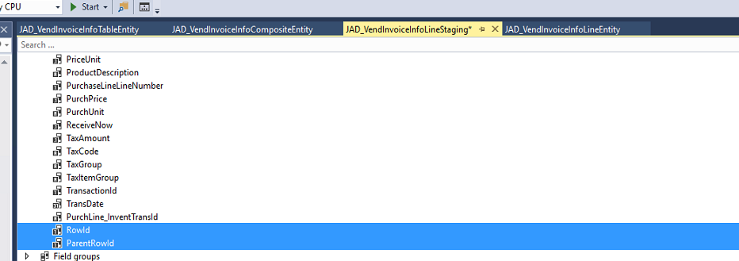
Line and Header staging: add rowId fields and index

Slide 42
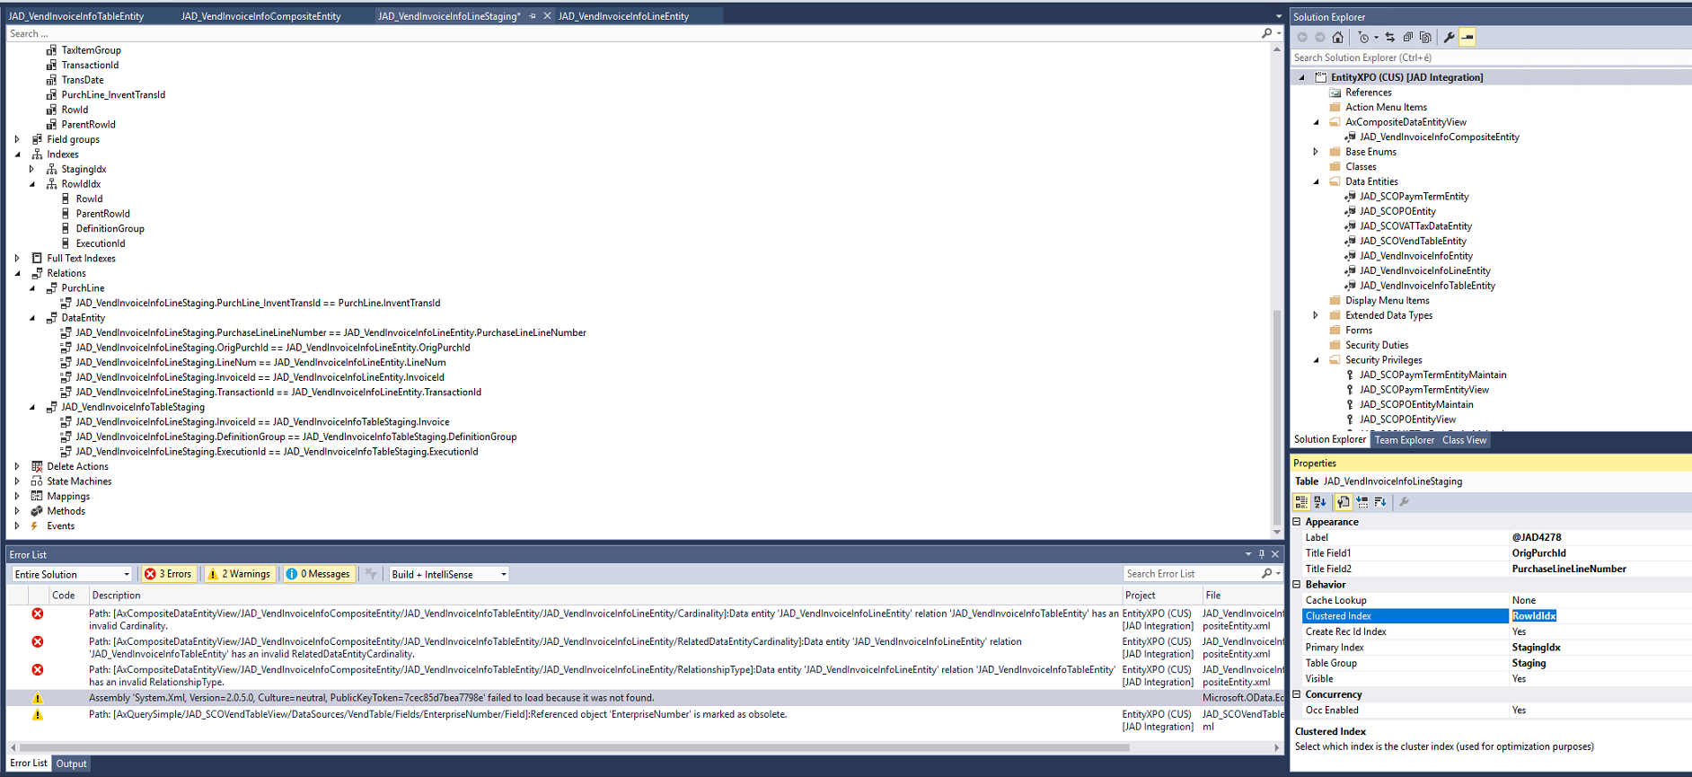
Line and Header staging: add rowId fields and index

Slide 43
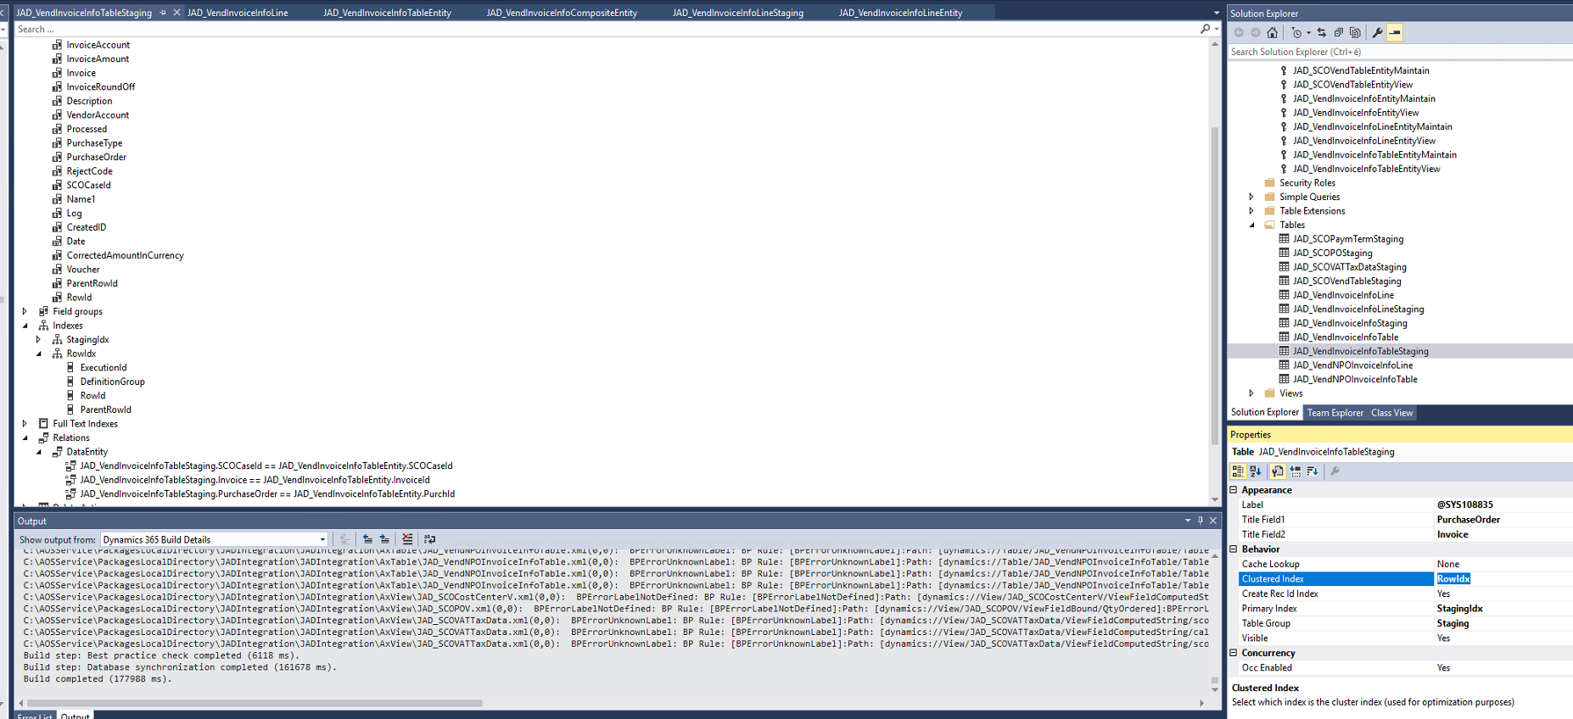
Line and Header staging: add rowId fields and index

Slide 44
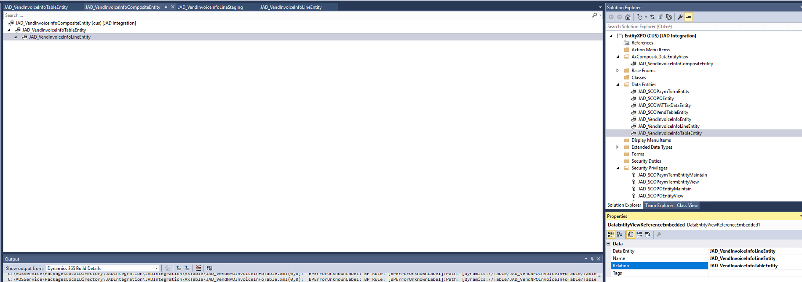
Create composite entity with relation

Slide 45
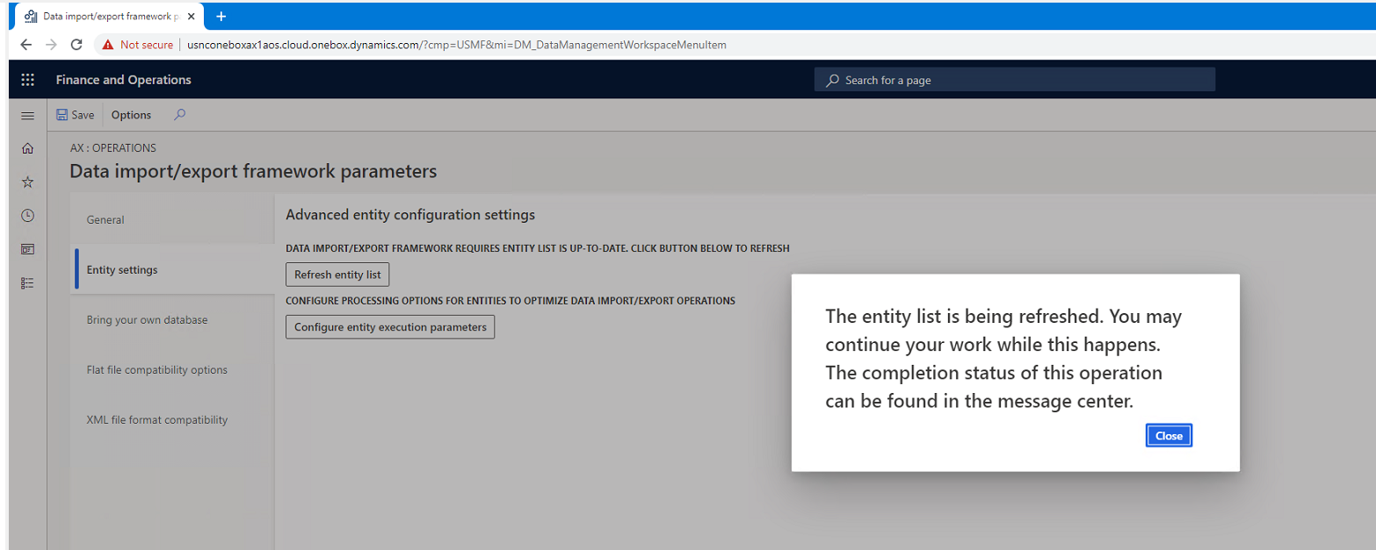
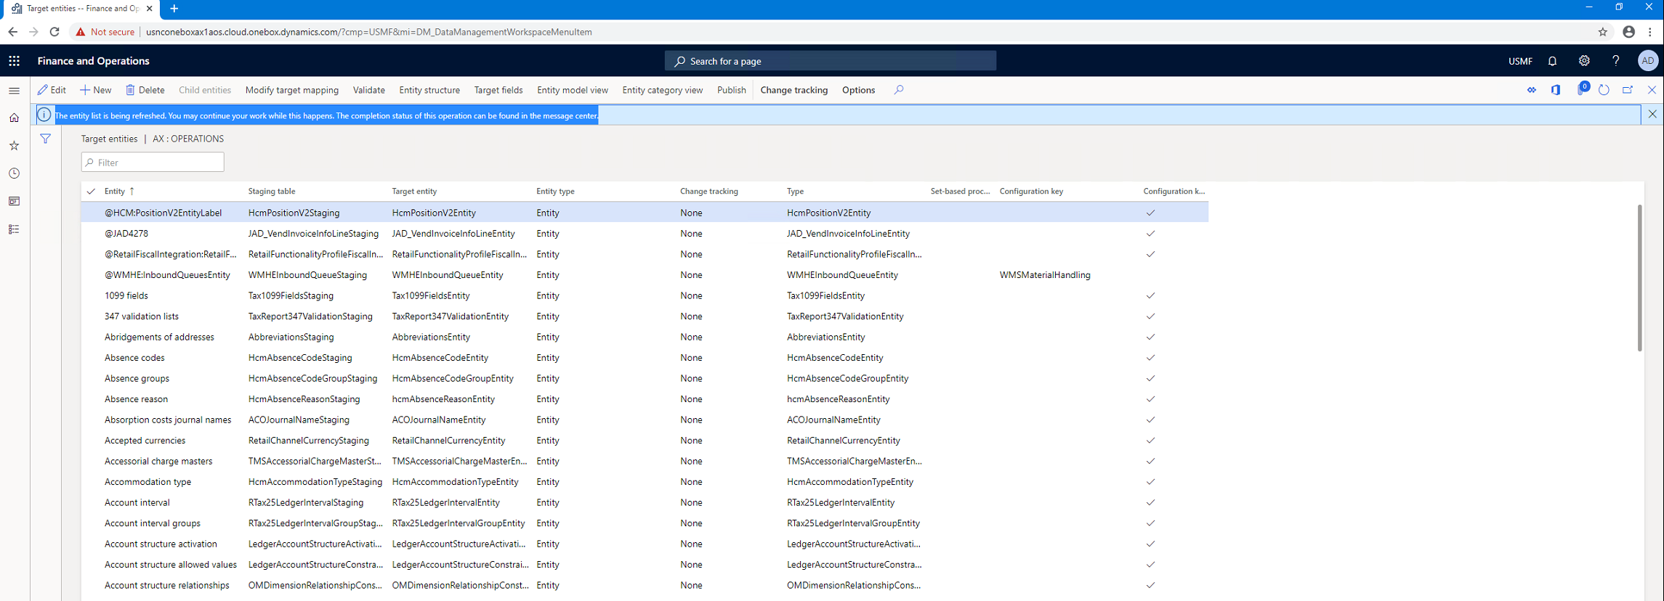
Refresh entity list

Slide 46
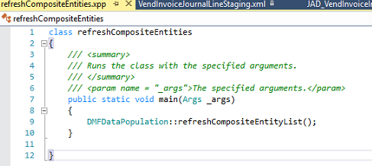
Alternative refresh
class refreshCompositeEntities
{
/// <summary>
/// Runs the class with the specified arguments.
/// </summary>
/// <param name = "_args">The specified arguments.</param>
public static void main(Args _args)
{
DMFDataPopulation::refreshCompositeEntityList();
}
}

Slide 47
Tapasztalatok

Slide 48
Tapasztalatok
„Given the large number of issues reported that end up being mitigated by cleaning up the execution history and staging table data and coupled with the fact that, the clean up jobs are not scheduled in most of the cases, we wanted to reach out and ask for your input on this topic.”
Microsoft tapasztalatok alapján fejleszt a cleanup jobokon

Slide 49
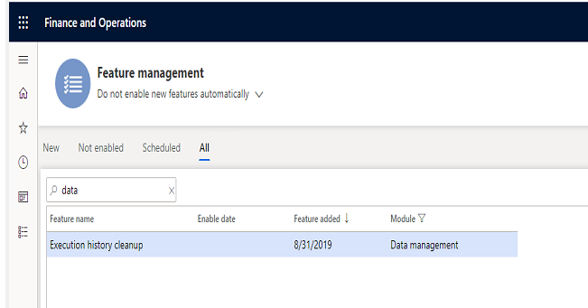
Tapasztalatok – data cleanup
Job history clean up (Platform update 29-től)
The job history clean-up functionality in data management must be used to schedule a periodic cleanup of the execution history. This functionality replaces the previous staging table clean-up functionality, which is now deprecated. The following tables will be cleaned up by the clean-up process.
All staging tables
DMFSTAGINGVALIDATIONLOG
DMFSTAGINGEXECUTIONERRORS
DMFSTAGINGLOGDETAIL
DMFSTAGINGLOG
DMFDEFINITIONGROUPEXECUTIONHISTORY
DMFEXECUTION
DMFDEFINITIONGROUPEXECUTION
The functionality must be enabled in feature management and then can be accessed from Data management > Job history cleanup.
Notes:
2 min

Slide 50
Tapasztalatok
http://daxvisionerp.com/data-entity-export-error-azure-storage-emulator-issue/
Notexists join nem lehet data entity datasourceban
Composite entity csak full push-t tud
Data entity not shown in Data entities list – label issue
Notes:
2 min

Slide 51
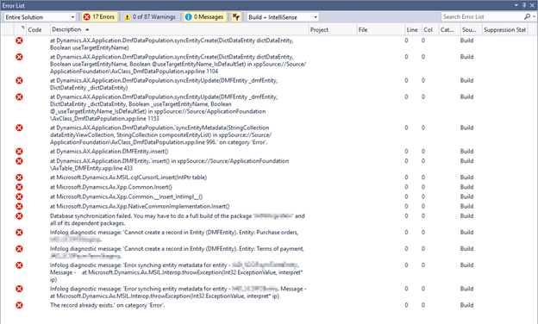
Tapasztalatok – build project
„Cannot create a record in Entity (DMFEntity)”

Slide 52
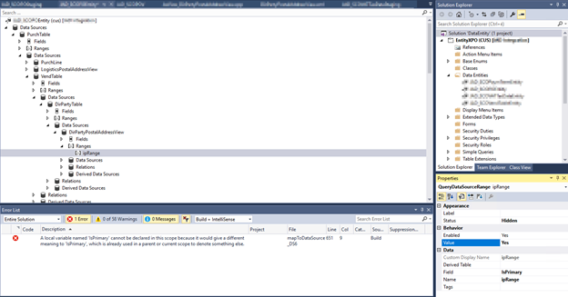
Tapasztalatok - IsPrimary
„Local variable named ‚isPrimary’ cannot be declared in this scope because it would give a different meaning to ‚IsPrimary’, which is already used in parent or current scope to define something else.”

Slide 53
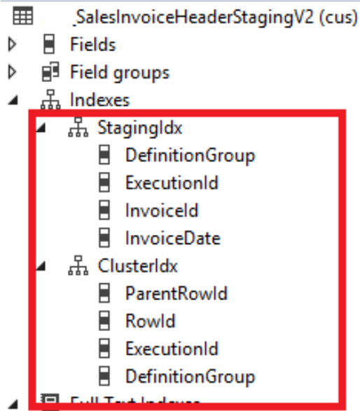
„The record already exisits” error composite entity exportnál
cluster & staging index?

Slide 54
Miről volt szó
Data entity áttekintés
Entity demo
Data management
OData
Composite data entity
Tapasztalatok

Slide 55
Köszönöm
Prokopecz Péter
info@daxvisionerp.com
DAXVision ERP Consulting Kft.
http://www.daxvisionerp.com/

